Slide 1
Image Clustering using kmeans Algorithm
Group Members:
Sachin.K.Lohith
Siddesh.B.B
Sunil.P
Bhargav Kulkarni

Slide 2
What is Clustering?
Attach label to each observation or data points in a set
You can say this “unsupervised classification”
Clustering is alternatively called as “grouping”
Intuitively, if you would want to assign same label to a data points that are “close” to each other
Thus, clustering algorithms rely on a distance metric between data points
Sometimes, it is said that the for clustering, the distance metric is more important than the clustering algorithm

Slide 3
K-means Overview
An unsupervised clustering algorithm
“K” stands for number of clusters, it is typically a user input to the algorithm; some criteria can be used to automatically estimate K
It is an approximation to an NP-hard combinatorial optimization problem
K-means algorithm is iterative in nature
It converges, however only a local minimum is obtained
Works only for numerical data
Easy to implement

Slide 4
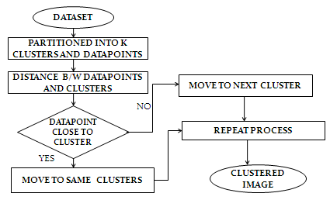
K-means Algorithm

Slide 5
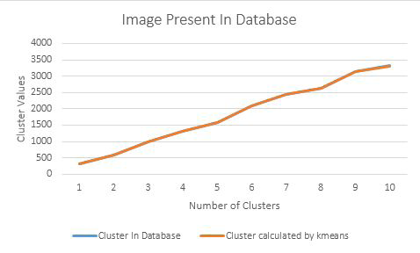
Performance Analysis
Case 1: Image is present in database:

Slide 6
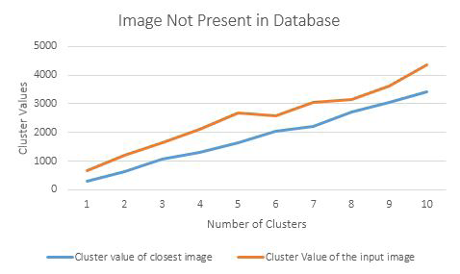
Performance Analysis
Case 1: Image is not present in database:

Slide 7


Simulation Result:
Image 1:

